Slide 1
CSC 578 Neural Networks and Deep Learning
Fall 2018/19
6. Convolutional Neural Networks
(Some figures adapted from NNDL book)

Slide 2
Convolution Neural Networks
Convolutional Neural Networks
Convolution, pooling and fully-connected layers
Convolution kernel/filter
Local receptive field
Convolution Kernels
Shared Weights and Biases
Shift invariance
Learned weights
Pooling
Max, average pooling
CNN Learning
Example Code

Slide 3
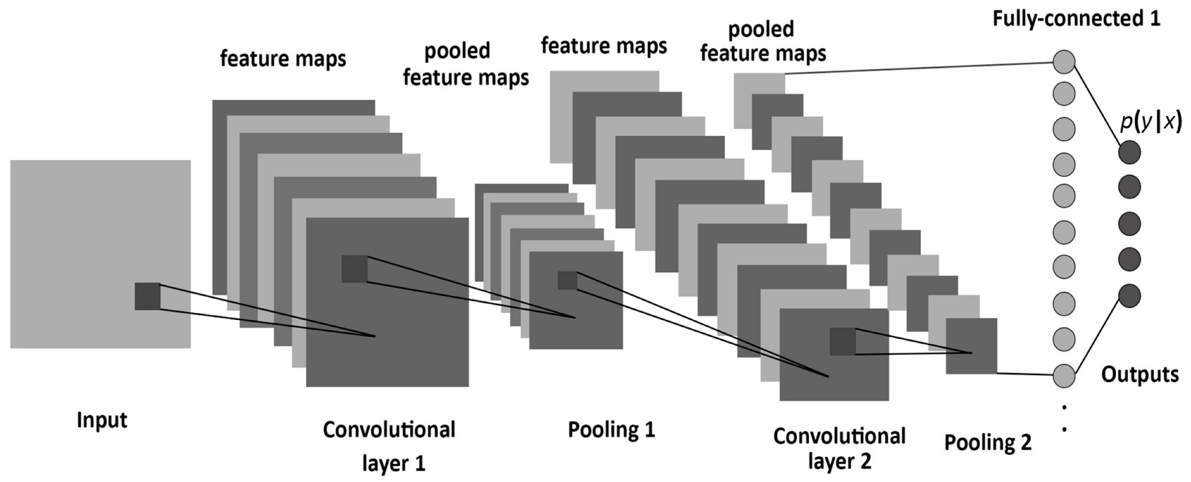
1 Convolutional Neural Networks
Convolutional Neural Networks (CNNs) are a variation of a multilayer neural network, typically used for recognizing/classifying 2D images.
A CNN consists of an input and an output layer, as well as multiple hidden layers. The hidden layers of a CNN typically consist of convolutional layers, pooling layers, and fully connected layers.

Slide 4
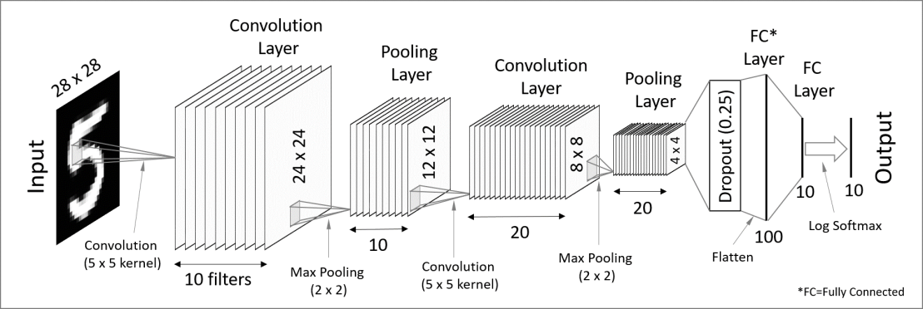
Convolutional layers apply a convolution operation to the input. The operation applies a filter function/kernel on a receptive field/window of some size over the input data.
A receptive field is moved/slid over the input, stopping at every pixel or skipping over a fixed number of pixels (stride).
You can apply as many different filter functions, where each function creates a convolution feature map.

Slide 5
Next, for each convolution feature map, a pooling operation is applied which combines a cluster of convolution features to a single value.
Common functions are max pooling and average pooling.
Typically a CNN consists of several convolution and pooling layers.

Slide 6
Then the last pooling layer is flattened to a 1D vector (possibly after dropping some nodes), which gets connected a network of fully connected layers. It is in principle the same as the traditional multilayer neural network.
Common functions are max pooling and average pooling.
Typically a CNN consists of several convolution and pooling layers.

Slide 7
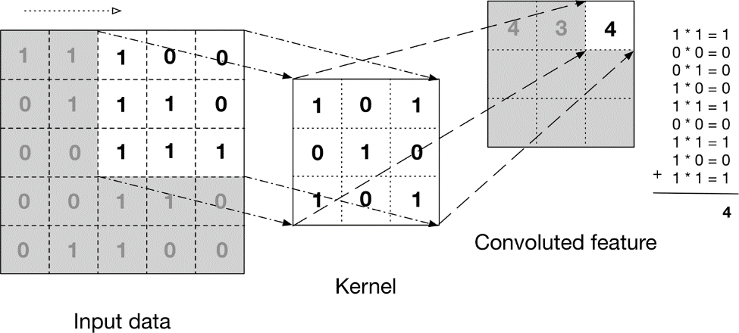
2 Convolution Kernel

Slide 8
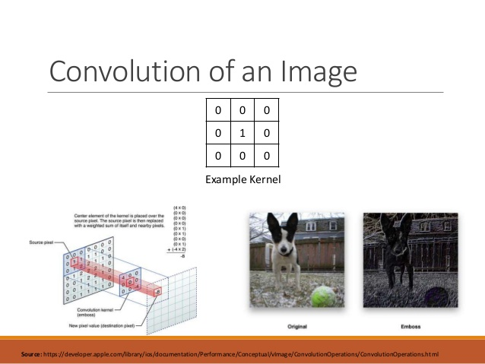
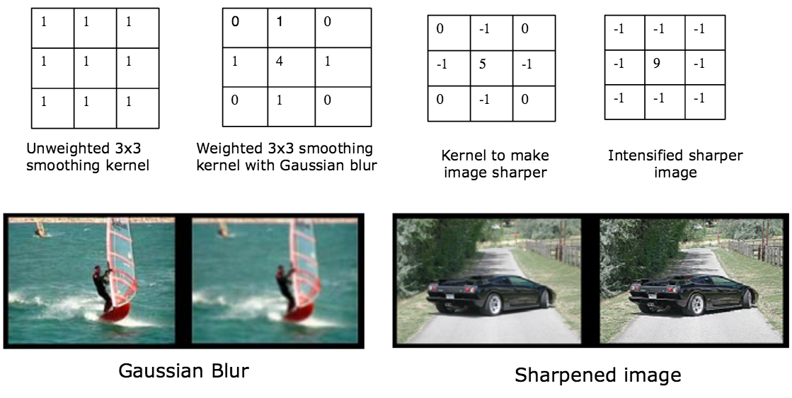

Slide 9
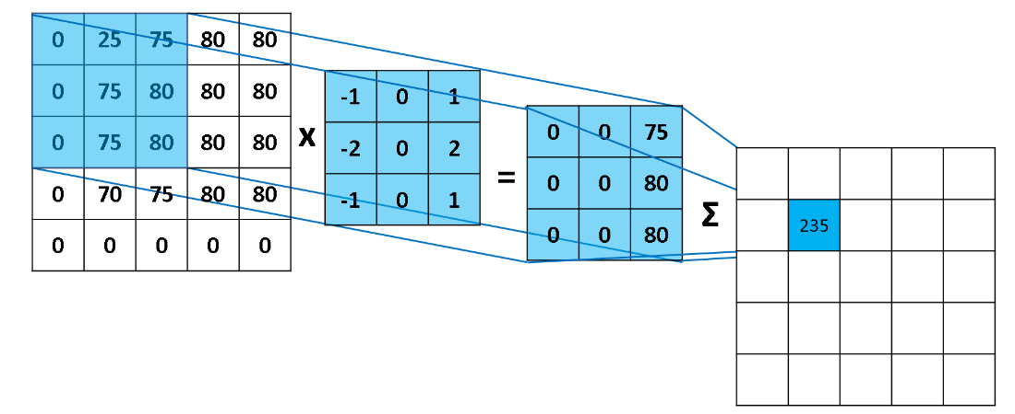
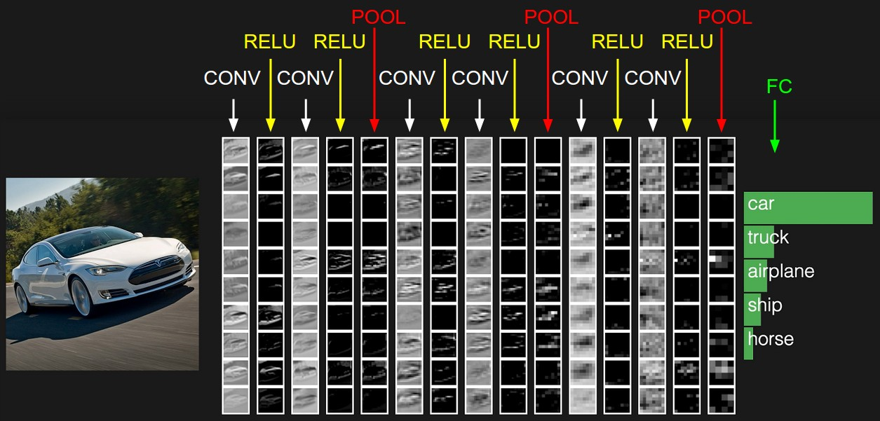
Sometimes an activation function (applied after kernel) is considered a separate layer.

Slide 10
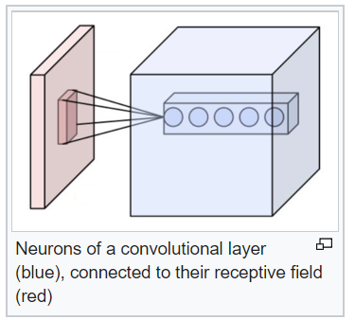
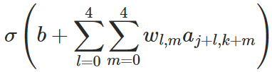
3 Shared Weights and Biases
Nodes in a receptive field to a node on the convolution layer are connected with weights. There is also a bias. Those weights and bias are shared – same values are used for a given filter as a receptive field is moved on the same (input or intermediate convolutional) layer.
For example, the output of the jkth convolution node from a 5x5 receptive field would be
And those weights are learned by training.

Slide 11
By sharing the same weights (and bias) for the same filter, all the neurons in a convolution layer detect exactly the same feature in the preceding layer (input or intermediate pooled layer), just at different locations.
This makes a filter “shift invariant” – being able to find the feature anywhere in the entire image (or the preceding layer) wherever it occurred.
For example, filters could detect edges, lines, corners and blobs of color.
Animation of sliding window of receptive field, max pool etc.

Slide 12
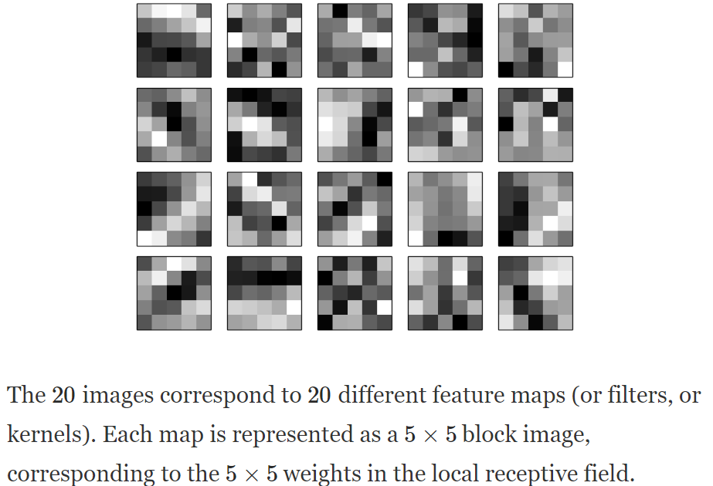
MNIST example (from the NNDL book):

Slide 13
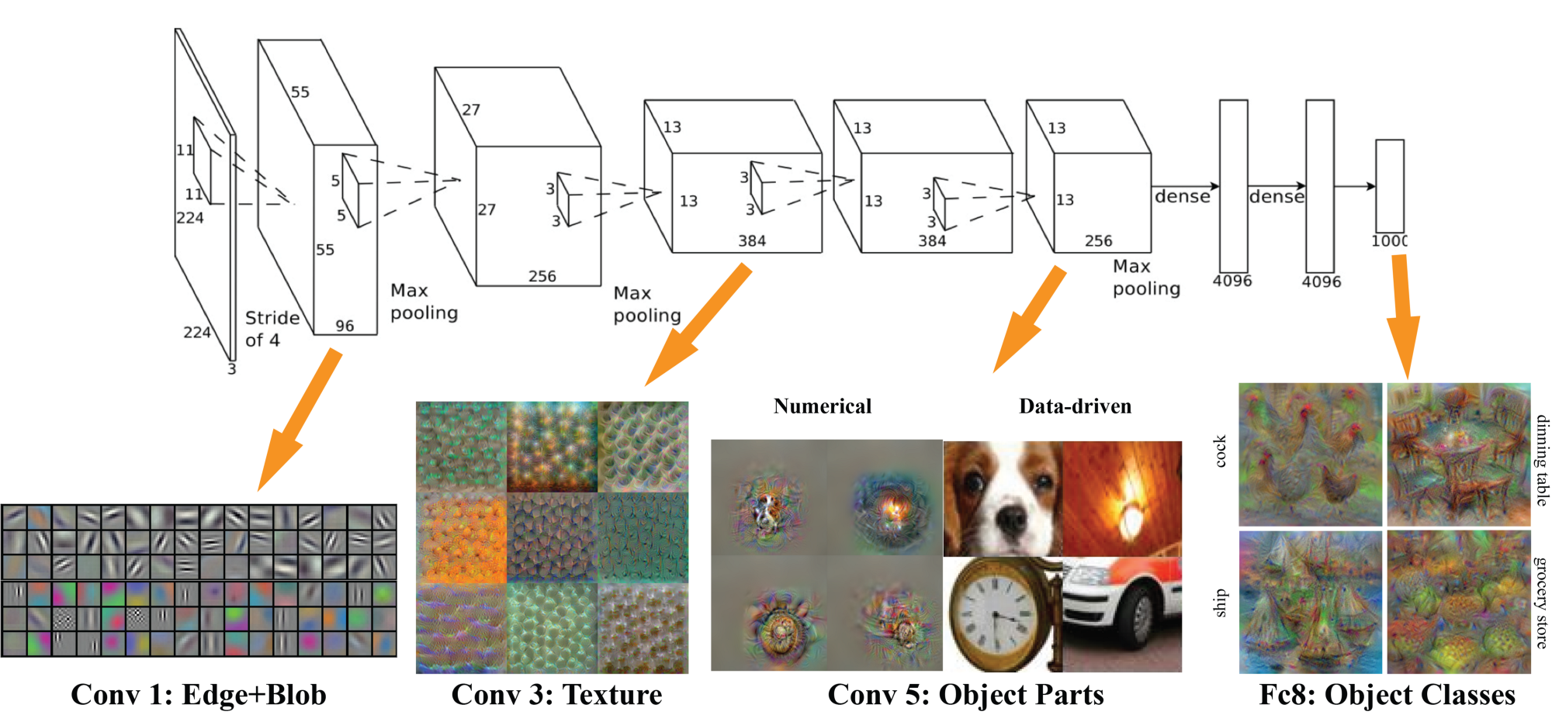
Color images typically have 3 channels (RGB), thus the input images have the depth of 3.
Example: AlexNet

Slide 14
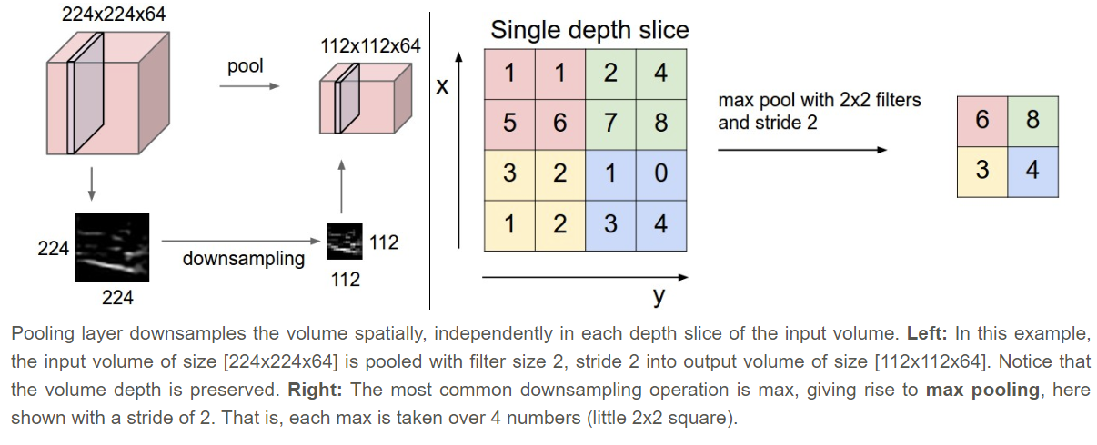
4 Pooling
A pooling layer takes each feature map output from the convolutional layer and prepares a condensed feature map.

Slide 15
4 CNN Learning
CNNs are a variation of feed-forward deep neural network. So all of the concepts we learned in the previous sections apply, in particular:
Neuron Activation functions
Cost/loss functions
Cost/loss minimization
Other hyper-parameters
CNN learning is to learn the weights between layers.
But the weights between a hidden/convolution layer and its preceding layer are a kernel (modulo activation function). So essentially this learning is to learn convolution kernels.

Slide 16
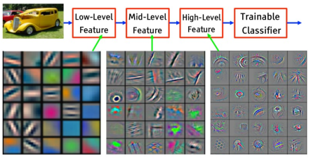
Example of learned kernels

Slide 17
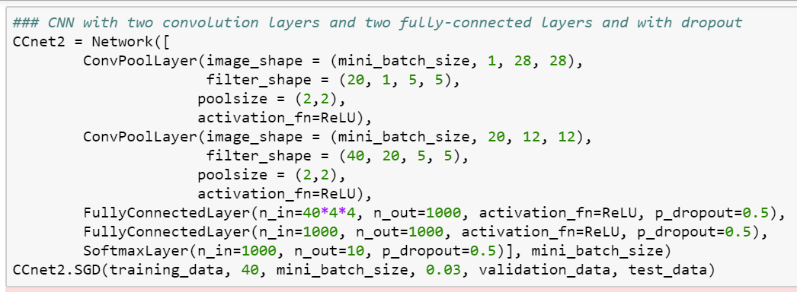
5 CNN Code (from NNDL book)
The code uses Theano (instead of Keras).

